Slide 1
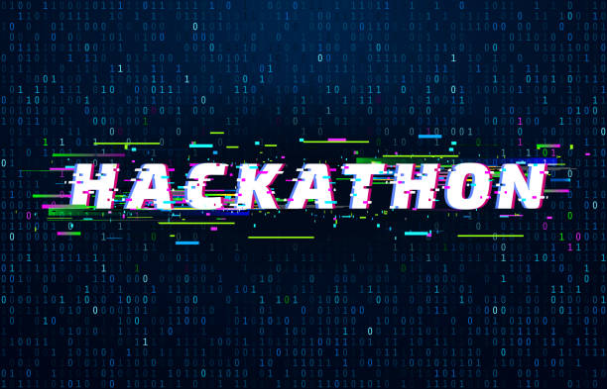


Slide 2

TEAM : SAFFRON
NISHA KAVA
SALONI KAKASANIA
TANVI AGRAWAL
PAYAL PATEL

Slide 3

PROBLEM STATEMENT
Online Voting System using fingerprint sensor

Slide 4
PROBLEM
In developing countries like "INDIA", the election commission follows manual voting mechanism which is done by the electronic voting machine. But instead of this, The poll rate of India has only increased by 4 percent from 1952 to 2014. So a machine was required to automate the process and can be avail machine is placed in the poll booth centre and is monitored by higher officials, due to some illegal activities the polling centre are misused and people's right to has been denied. This seldom occurs in rural areas as well as in urban cities because the educated people are not interested in casting their votes to candidates who represent their respective areas. To ensure 100% voting, automation came into play. But this automated system has been approved only on some developed countries since security have not been ensured to a large extent. The poll percentage of India have never exceeded 67% till date. The main problem is people either do not leave in the area where they are registered as a voter or they do not go to the poll centre because of any other reason. The queue at the poll centre is also one of the major reason for less poll percentage. Some people cast their vote, and approximate 2% of the vote each time become invalid, due to any reason.

Slide 5
Slide title 29
SOLUTION
To overcome all the drawbacks of traditional methods of voting. We have come up with an innovating solution to solve all the above-discussed problems. Fingerprint Based Voting Project is an application where the user is recognized by his finger pattern or IRIS (or any other biometrics in the future). Since the finger pattern of each human being is different, the voter can be easily authenticated. The system allows the voter to vote through his fingerprint. The fingerprint is used to uniquely identify the user. The fingerprint minutiae features are different for each human being. Fingerprint is used as an authentication of the voters. A voter can vote the candidate only once, the system will not allow the candidate to vote for the second time. The system will allow admin to add the candidate name and candidate photo who are nominated for the election. Admin only has the right to add a candidate name and photo who are nominated. Admin will register the voter's name by verifying voter. Admin will authenticate the user by verifying the user’s identity proof and then admin will register the voter. The number of candidates added to the system by the admin will be automatically deleted after the completion of the election. Admin has to add the date when the election going to end. Once the user has got the user id and password from the admin the user can log in and vote for the candidate who is nominated.

Slide 6
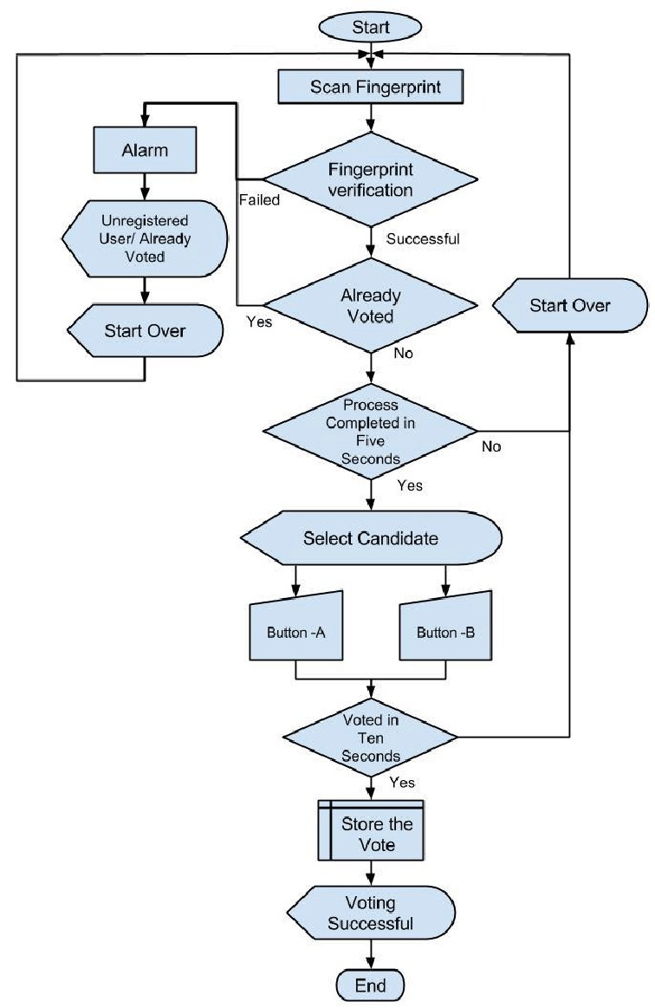
flowchart

Slide 7
Product USP
This system overcomes most of the problems that are faced in the traditional approach of the voting system. The efficiency of this system depends upon the web interface, its usability. This will surely ensure a safer voting method which is very much what is required for the healthy growth of a developing nation. The proposed fingerprint based voting system which is better and faster than the previous system. The new system prevents access to illegal voters, provides ease of use, transparency and maintains the integrity of the voting process. The system also solves the problem of RIGGING, means it does not allows a user to vote multiple times since his fingerprint is recorded once in an election. The system does not allow the voter to vote for more than once in the same election. The fingerprint-based voting system has provided a chance to avoid invalid votes, it reduces the polling time, easy carrying to polling center from the polling box, Reduce the staff of the voting center. It provides easy and accurate cutting without any trouble.

Slide 8

TECH STACK
Frontend : html, css, js
Backend : ajax, jquery
Solidity : Smart Contract
Ethereum is a decentralized blockchain platform that enables the development and execution of smart contracts and decentralized applications (DApps).
Truffle
Base network : ganache - Ganache provides a local blockchain environment that runs on your computer, allowing developers to simulate the behavior of an Ethereum network without the need for connecting to the main Ethereum network or deploying contracts to a public testnet. This local blockchain environment is commonly referred to as a "ganache-cli" or "ganache" network.

Slide 9
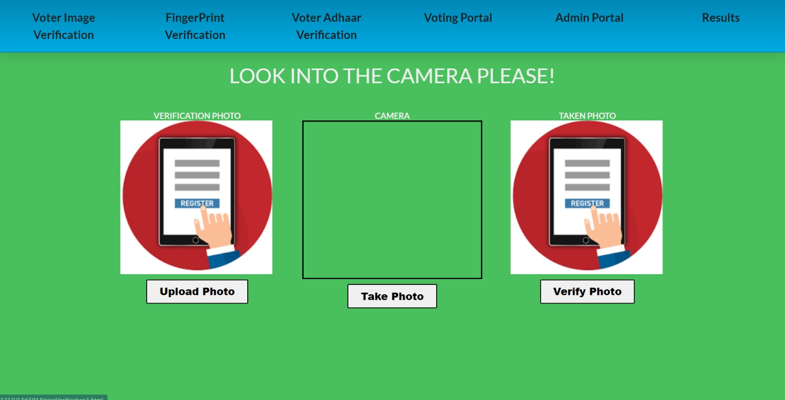

Slide 10
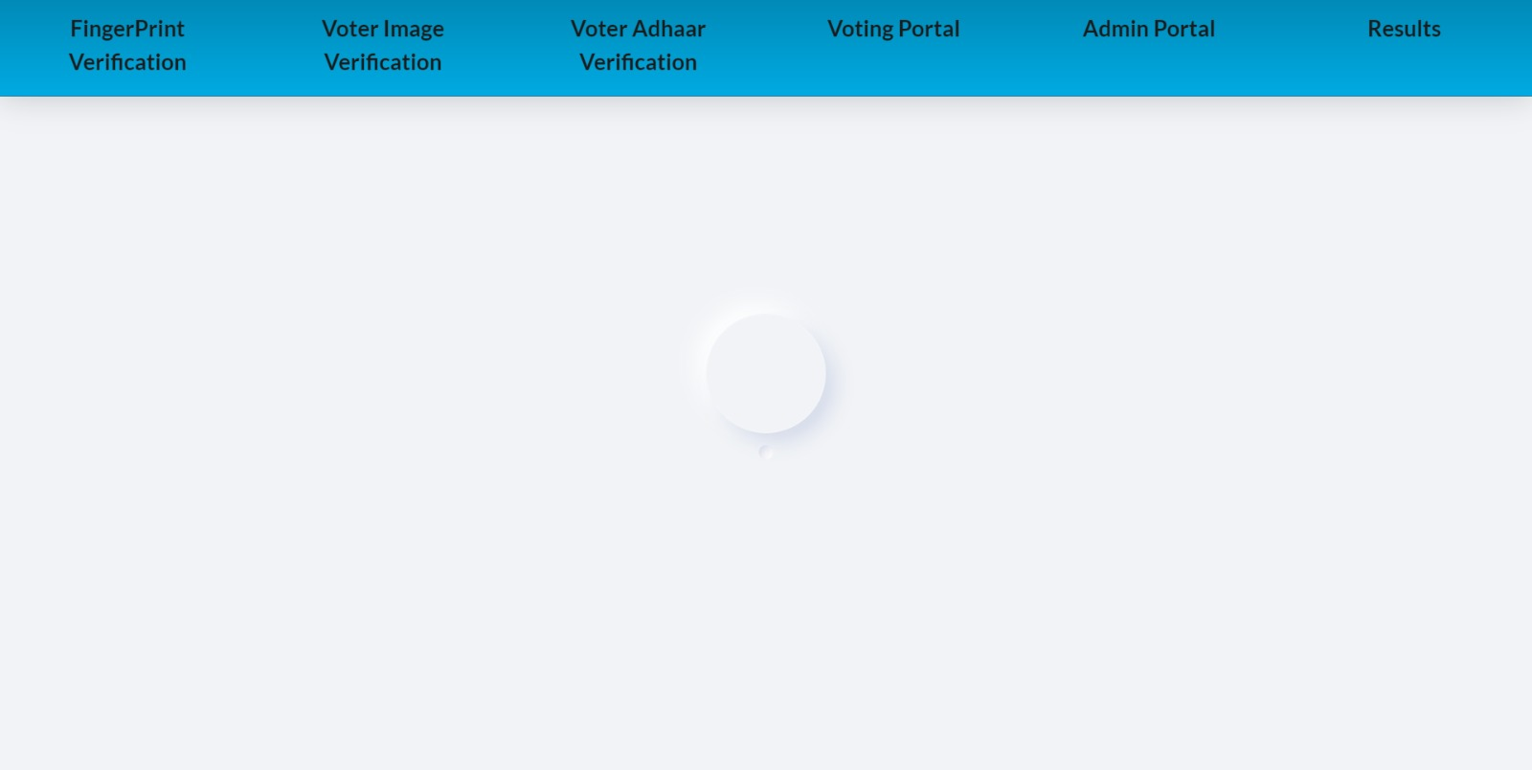
Slide title 29

Slide 11
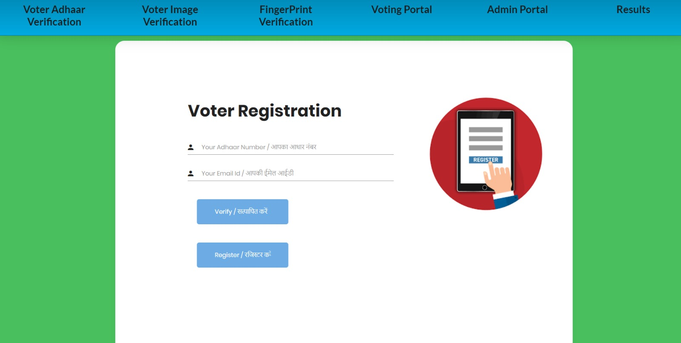
Slide title 29

Slide 12
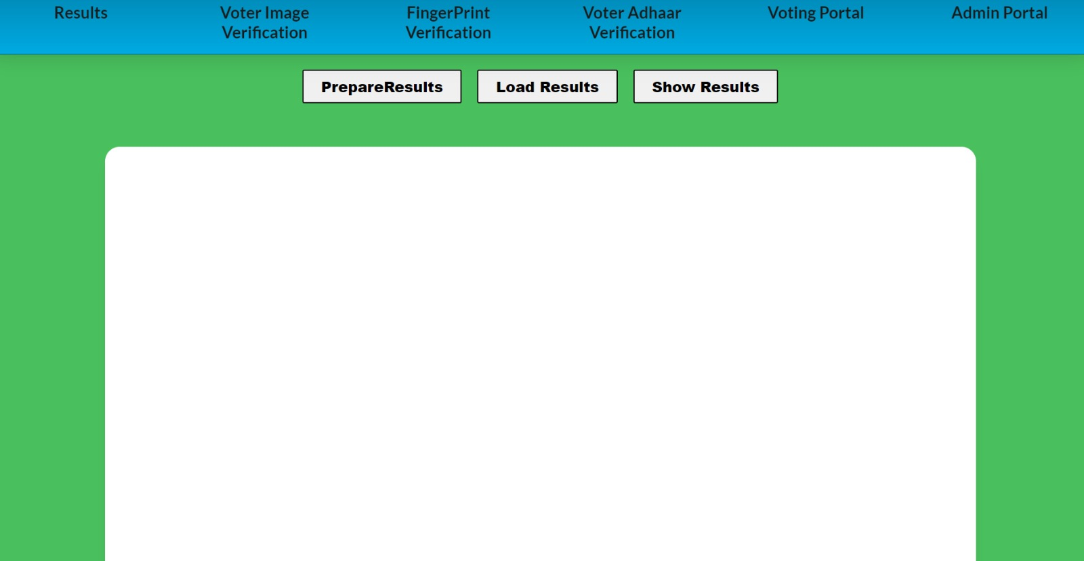

Slide 13
Thank you

